Slide 2
Agile in High Performance Computing
UCAR SEA Conference 2012
February 21, 2012
Jessica A. Popp, PMP
PMO & Operations Management
Whamcloud, Inc.
Jessica@whamcloud.com

Slide 3
Agenda
My HPC Environment
Lustre Project Management History
Methodology Options
What’s So Special About My Projects?
The Right Tool For The Job
Agile for HPC
Whamcloud Agile Principles
Why Not More of Us?

Slide 4
My HPC Environment
Lustre Parallel File System
TOP500: 8 of top 10; 64 of top 100
Supports
Tens of thousands of clients
Tens of PBs of storage
Hundreds of GB/s of aggregate IO throughput
Application
High-Level IO Library
IO Middleware
IO Forwarding
Parallel File System
I/O Hardware
Notes:
Major Partners include, LLNL, ORNL, Sandia Nat’l Labs, IU,
Some of you here may have Lustre environments as well.

Slide 5
Lustre Project Management History
Years | Tools | Results
1999-2003 | No Project Mgt | Lustre 1.0: 2 years late*
2004-2007 | TSP/PSP | Reliably late; but we had tons of data
2007-2010 | MS-Project & Bugzilla | ~50% of milestones on time
2010-Present | Jira/Greenhopper | 94% milestones on time**
*Anecdotal information, exact delay information not available
**Milestones are considered on time if they are delivered within 5 days of committed delivery date.
Notes:
TSP/PSP – Team Software Process, Personal Software Process – developed at Carnegie Melon, focuses on personal measurement and reduction of defects as measured throughout the process. Work rates are measured in LOC/hour. Process depends heavily on thoroughly written designs and hours, LOC and defect count tracking. Can be tedious.
2007 – First PM was hired.
2008-2010 – No tool purchasing authority – very tedious statusing process, difficult both to get a status from engineers and then to collate it into anything of meaning.

Slide 6
What’s So Special About My Projects?
Size & Complexity
Linux Kernel
Average Feature Check-In 4k LOC (9k-15K is not unusual)
Managing community contributions
Team Distribution
US, Canada, England, Scotland, France, Russia, China
11 Time Zones (Down from 18)
Everyone works from home
Non-Recurring Engineering (NRE) Contracts
Fixed-Bid Government Contracts (Risky up front estimates)
Requirements to hit performance/size values never hit before (R&D)
Notes:
As a project manager – what is unique about this environment versus all the other environments that I have management SW projects.
Linux Kernel – I can’t apply my Userspace C skills to judge their progress
Work from home wherever you live, regardless of skill set
4 native languages (is that all?)

Slide 7
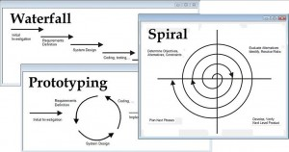
Methodology Options
Waterfall /Gated
Initiation/Discovery
Scoping
Design
Develop
Test/Validate
Demonstrate/Release
Prototyping
Quick cycles to test an idea or concept
Risk is not throwing away the prototype code when necessary
Spiral
Multiple passes are made through each phase
Exploring with greater depth until adequate solution or risk is arrived at
Notes:
Methodology options to consider
Water fall is uni-directional – the fall back for engineering- too monolithic – hard to turn the boat and make changes – not nimble enough.
Prototyping – seems like a good idea – test the code out – is our idea going to work? – Hard to get the traction to go back and properly to designs and not use the prototyped code.
Spiral is a luxury with it’s multiple passes through each phase: evaluate, research, try & test; rinse and repeat until we like the results – customers won’t pay us for that.
Good spiral explanation: http://newton.cs.concordia.ca/~paquet/wiki/index.php/Spiral_model
Needed to find a mode that would allow us to change directions quickly, see our mistakes quickly and give our customers confidence quickly that we were headed someone definitive. Nothing gave them less confidence than Waterfall – we would head off for huge chunks of time (12 weeks in some cases) with the expectations that we would emerge with a design doc – and then nothing – not a good feeling for either side. Engineers – can’t be left unattended for long periods of time.

Slide 8
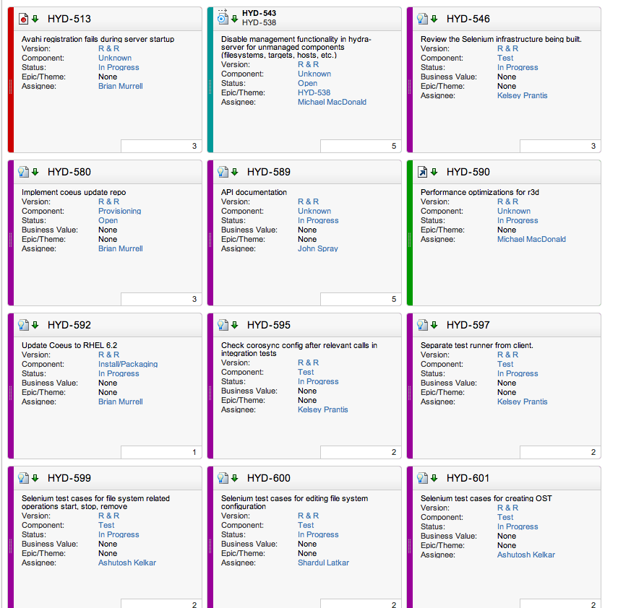
The Right Tool For The Job
The Team had some specific needs:
Browser-based for a geographically distributed team
Browser-based to support OS X, Linux, and even Windows
Does not require timesheets for accurate progress tracking
Engages engineers in the update process so PMs are not chasing remote engineers for status
Administrative controls that allow for managing customer access to view project portals
Notes:
We’ve all felt the pain of not having the purchasing or decision-making authority to pick the right tool. Well that changed for Lustre development when we started the Lustre-centric Whamcloud organization
I’ve had a long history with time sheets and I am not convinced of their value – I’ve watched many an engineer spend 30 minutes on Monday morning conjuring up data for his spreadsheet. Now THERE’s value for you.

Slide 9
Agile for HPC
Used from inception at Whamcloud
Started splitting our large development work into small definable chunks
Demonstrable items for every sprint
Design doc, test plan, prototype code, testable code
Something that moves the bar forward
We can see if we veer off track before it’s too late
No longer asking engineers for status
Close of Sprint: re-visit, analyze, re-plan if necessary
We don’t just plow forward, or “try to make up time”
Notes:
The first thing I did when I joined Whamcloud as Employee 3 (or 2) depending on whether you tend to count starting with 0 was to choose our Agile toolkit. This way we were able to start our very first project using Greenhopper.
Something we can show the customer that isn’t hand-wavy.
-We treat sprint misses as early bell weathers to fix the issue rather than plowing ahead.

Slide 10
Whamcloud Agile Principles
3 or 4 week sprints
Self-contained, self-directed teams tied to a single purpose
Single cards must be 5 or fewer days in duration
Close your cards as you go
Dedicated sprint planning meetings each cycle
Daily SCRUM meetings vary by team
Notes:
I do “Agile but”
Every team defines their specific operating principles

Slide 11
Why not More of Us?
Slow adoption of tools in this industry?
Perhaps many more are using than are talking about it?
Fear of adoption due to “We’re doing Agile, but…”?
Weak project management in general in HPC?
Project Management in the Hierarchy of SW Development?
Notes:
Thinking about what type of PM I see in

Slide 12

www.whamcloud.com/company/careers @whamcloud
Jessica Popp jessica@whamcloud.com @jessica80304

Slide 13
Appendix

Slide 14
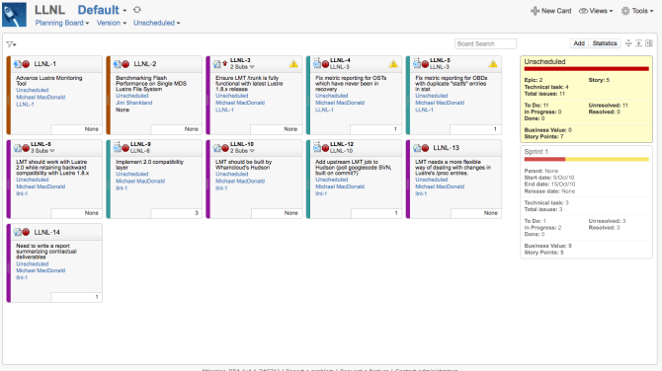
Planning Board

Slide 15
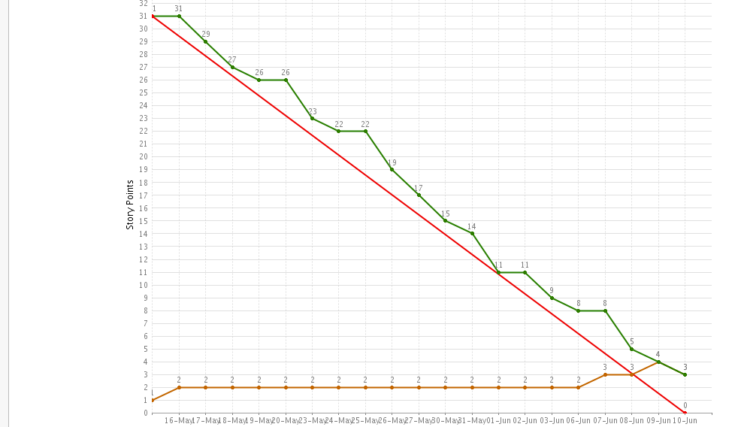
Burndown Chart

Slide 16
Thank You

